Slide 1
Designing for Online Courses: Key Differences
Presented by Ginette Tessier 28.01.22
© 2022 Acuitas CTD Ltd | All Rights Reserved

Slide 2
Designing for Online Courses: Key Differences
Presented by Ginette Tessier 28.01.22
© 2022 Acuitas CTD Ltd | All Rights Reserved

Slide 3
Designing for Online Courses: Key Differences
Training Terminology
Face to Face Training Online Training
Virtual Live Training
Online Courses (pre-recorded content)
© 2022 Acuitas CTD Ltd | All Rights Reserved

Slide 4
Designing for Online Courses: Key Differences
1 – I have already created at least one online course
2 – I am just starting to create my first online course
3 – I haven’t created any online courses yet
© 2022 Acuitas CTD Ltd | All Rights Reserved

Slide 5
Designing for Online Courses: Key Differences
Ginette Tessier
CEO and Online Business Alchemist at The Get That Gang
Services for experts to find their personal online goldmine
Started with Get That Course Online
Originally personal, demand increased
The Gang grew …
Marketing, Master Coach, NLP Trainer & Master Practitioner, Master Persuader
One half of The Complete Trainer with Sharon Gaskin, The Trainers Training Company; mentor for Bushra Azhar, The Persuasion School
© 2022 Acuitas CTD Ltd | All Rights Reserved

Slide 6
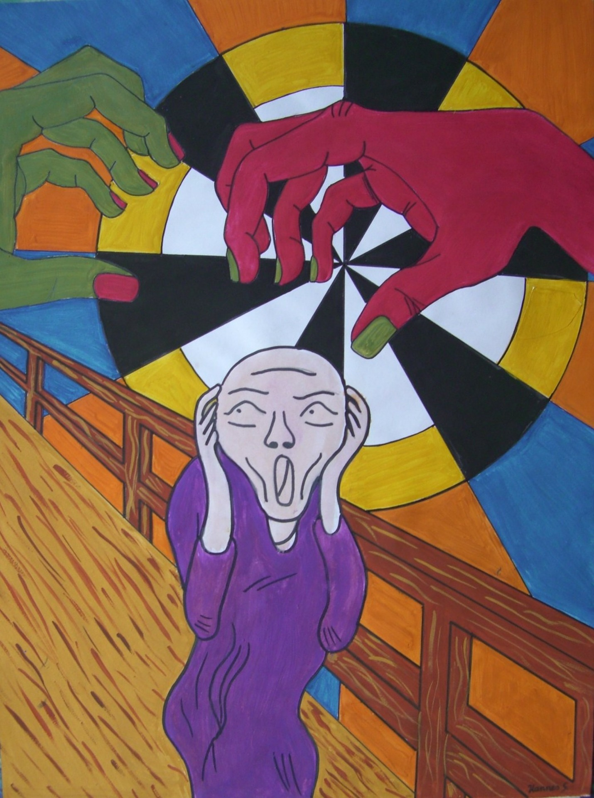
Designing for Online Courses: Key Differences
Some will be more relevant than others
Train Once, Sell Many
Learner-led Control
Global
Passive
Rapport
Motivation
Niche
Culture
Approach
Refresh
Connection
Communication
Benefits
Access
Currency
Competition
Creativity
Co-ordination
Absence
Engagement
Automation
Marketing
Features
Delivery
Tech Support
Structure
© 2022 Acuitas CTD Ltd | All Rights Reserved

Slide 7
Designing for Online Courses: Key Differences
Train Once, Sell Many / Global
#1 Niche
#2 Currency
#3 Culture
What is it?
Who you serve and how you serve them
The type of money you can (will) accept AND the method
The typical mindset of an online learner differs by nationality
How is it different?
Bigger potential audience AND competition
Global course currency usually USD
Questions and engagement are not reliable indicators
What can I do?
Choice: stay as is or expand reach (if possible)
Choice: if global desired, seriously consider USD
Bigger efforts to understand your learners’ backgrounds
© 2022 Acuitas CTD Ltd | All Rights Reserved

Slide 8
Designing for Online Courses: Key Differences
Train Once, Sell Many / Absence
#4 Automation
#5 Tech Support
#6 Marketing
What is it?
Providing information and processes without direct intervention
Answering queries / dealing with tech issues
Talking about what you know, making offers
How is it different?
Unlikely to need much if a small / non-existent list of contacts
You’re expected to know everything (and reset all passwords!)
Depends on how you integrate it with your business model
What can I do?
Think about /decide who you want to target (B2B or B2C)
Find a hosting solution that offers a level you need
Work out your business model, then marketing plan
© 2022 Acuitas CTD Ltd | All Rights Reserved

Slide 9
Designing for Online Courses: Key Differences
Train Once, Sell Many / Passive
#7 Approach
#8 Competition
#9 Refresh
What is it?
Your preferred business model
The other opportunities available to get the same solution
How often your information needs updating
How is it different?
Depends on how big a part of your business you want it to be
Usually face to face is compared like for like – not online courses!
Can be easier to update face to face training!
What can I do?
Consider complementary vs stand-alone; B2B or B2C
Do the comparison for them in your marketing
Construct in a way that allows easy lesson switching / replacement
© 2022 Acuitas CTD Ltd | All Rights Reserved

Slide 10
Designing for Online Courses: Key Differences
Learner-led Control / Rapport
#10 Connection
#11 Creativity
#12 Communication
What is it?
The relationship your learner feels towards you
The methods you use to achieve the learning objective
The way you initiate and stay in contact with your learners
How is it different?
Easier to do in real time!
Can’t rely on group work, or ‘forced’ self-reflection
Doesn’t necessarily happen simultaneously
What can I do?
Ensure you are visible, approachable and available
Go back to basics – what am I trying to achieve, how can online help?
Think about what will be easiest, most comfortable and friendly
© 2022 Acuitas CTD Ltd | All Rights Reserved

Slide 11
Designing for Online Courses: Key Differences
Learner-led Control / Engagement
#13 Features
#14 Structure
#15 Delivery
What is it?
Specific elements that facilitate access / completion
The way in which you construct your training
The way in which you present your training
How is it different?
You can easily supply paper and pens in a classroom …
Much MUCH smaller individual lessons (5 minutes)
Being on camera is (almost) non-negotiable – in some places!
What can I do?
Choose a hosting solution that will best suit your target audience
Chunk your content down to the smallest possible learning
Think about the lesson objective: inspire, inform or incite?
© 2022 Acuitas CTD Ltd | All Rights Reserved

Slide 12
Designing for Online Courses: Key Differences
Learner-led Control / Motivation
#16 Benefits
#17 Co-ordination
#18 Access
What is it?
The emotional gain learners think they will get from your course
The timely delivery of information and encouragement
How easy it is for learners to get to you, their trainer
How is it different?
The most important element in your sales and marketing
Potentially not everyone will start or finish at the same time
You may not even be in the same time zone, let alone country!
What can I do?
Concentrate on being the solution to pain points (client / learner)
Build this into your structure and use automation
Work with your target market’s needs and your boundaries
© 2022 Acuitas CTD Ltd | All Rights Reserved

Slide 13
Designing for Online Courses: Key Differences
© 2022 Acuitas CTD Ltd | All Rights Reserved

Slide 14
Designing for Online Courses: Key Differences
Special Offer for VIP members of The Training Designers Club
One session of mentoring for 50% discount:
only £125 + VAT
(normally £250 + VAT)
Email: GT@GetThatCourseOnline.com
Facebook Group: https://www.facebok.com/groups/TheGetThatGang
(must be booked by end March 2022)
© 2022 Acuitas CTD Ltd | All Rights Reserved

